Slide 1
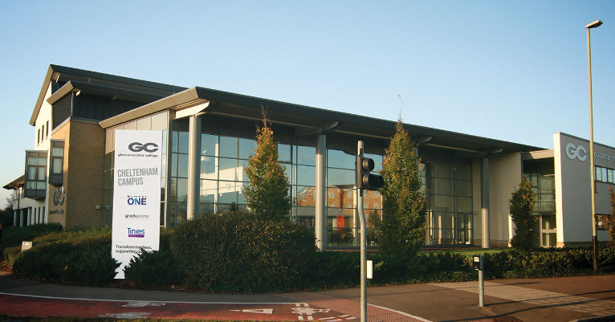

Multimedia presentation click on the arrows to progress click below to start
Start

Slide 2
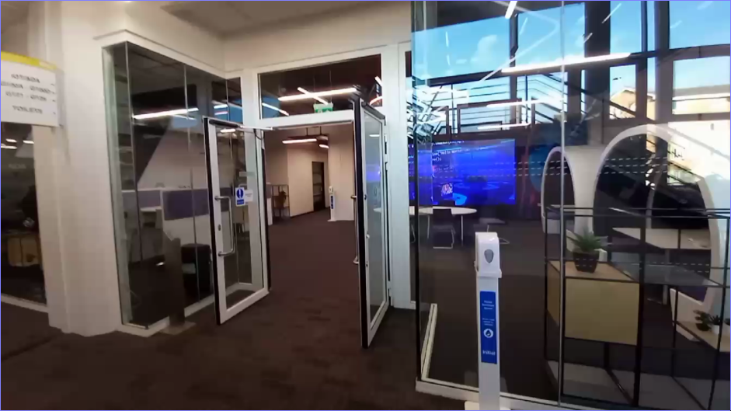
Here's the entrance to the college's IT department.
On the right are some study booths.

Slide 3
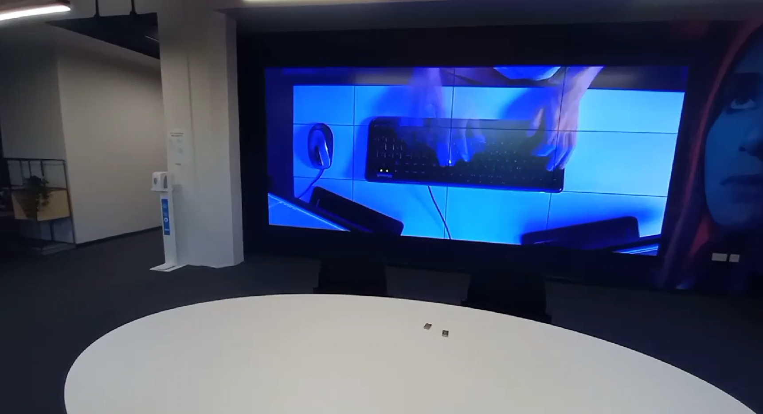
Is the main entrance ramp with tables chairs and study booths.
back

Slide 4
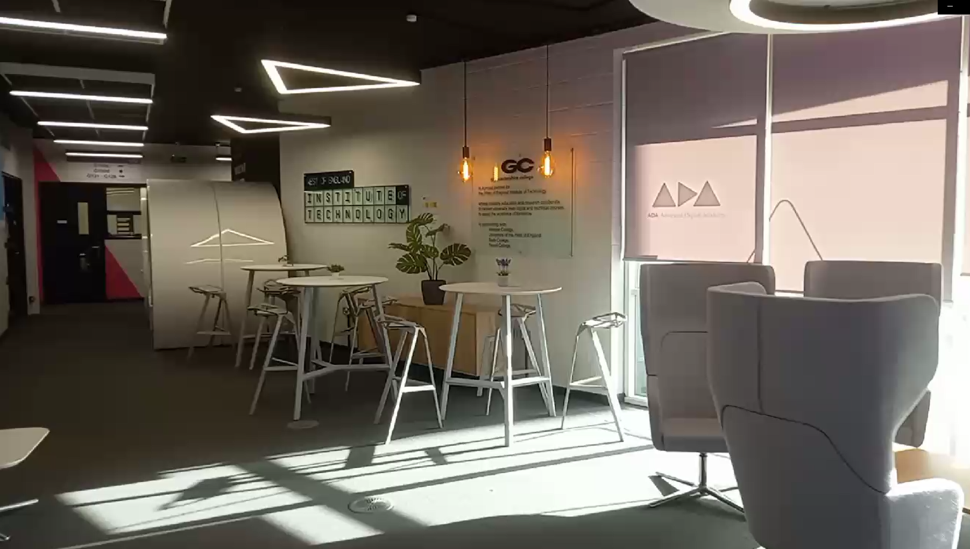
Here is the main area with chess for studying and hanging out.
back

Slide 5
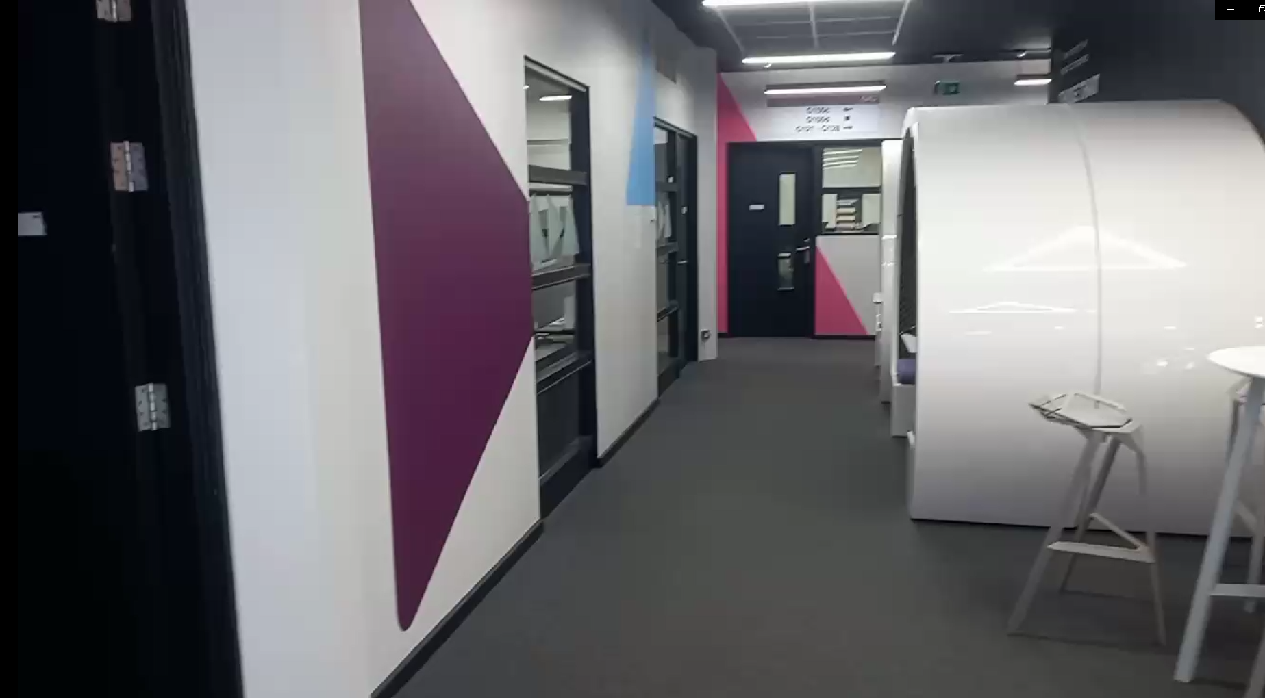
back

Slide 6
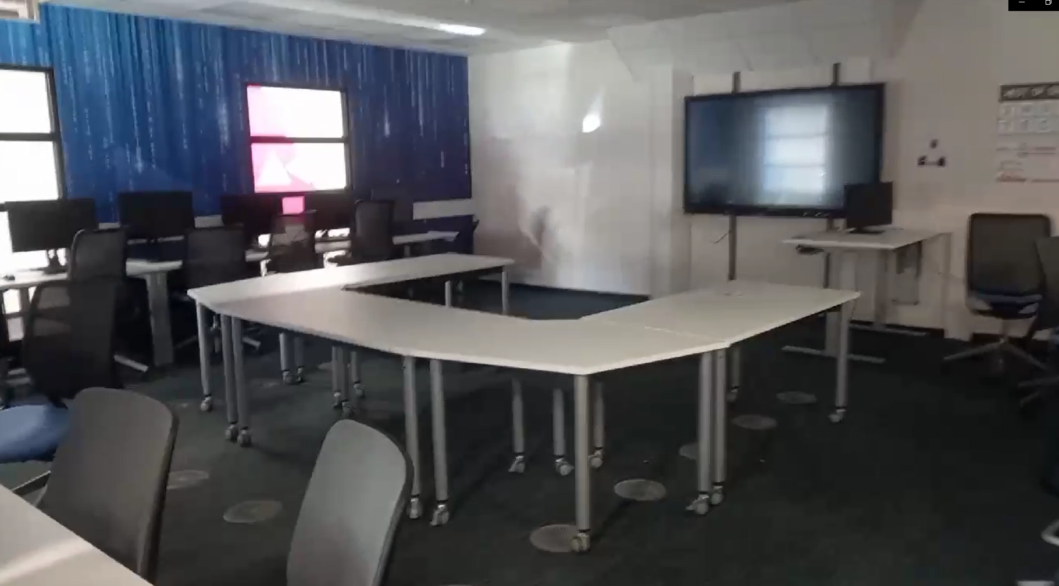
Here is a classroom as you can see it has comfortable chairs with a high-resolution monitor at the front and the computers are very good quality.
back

Slide 7
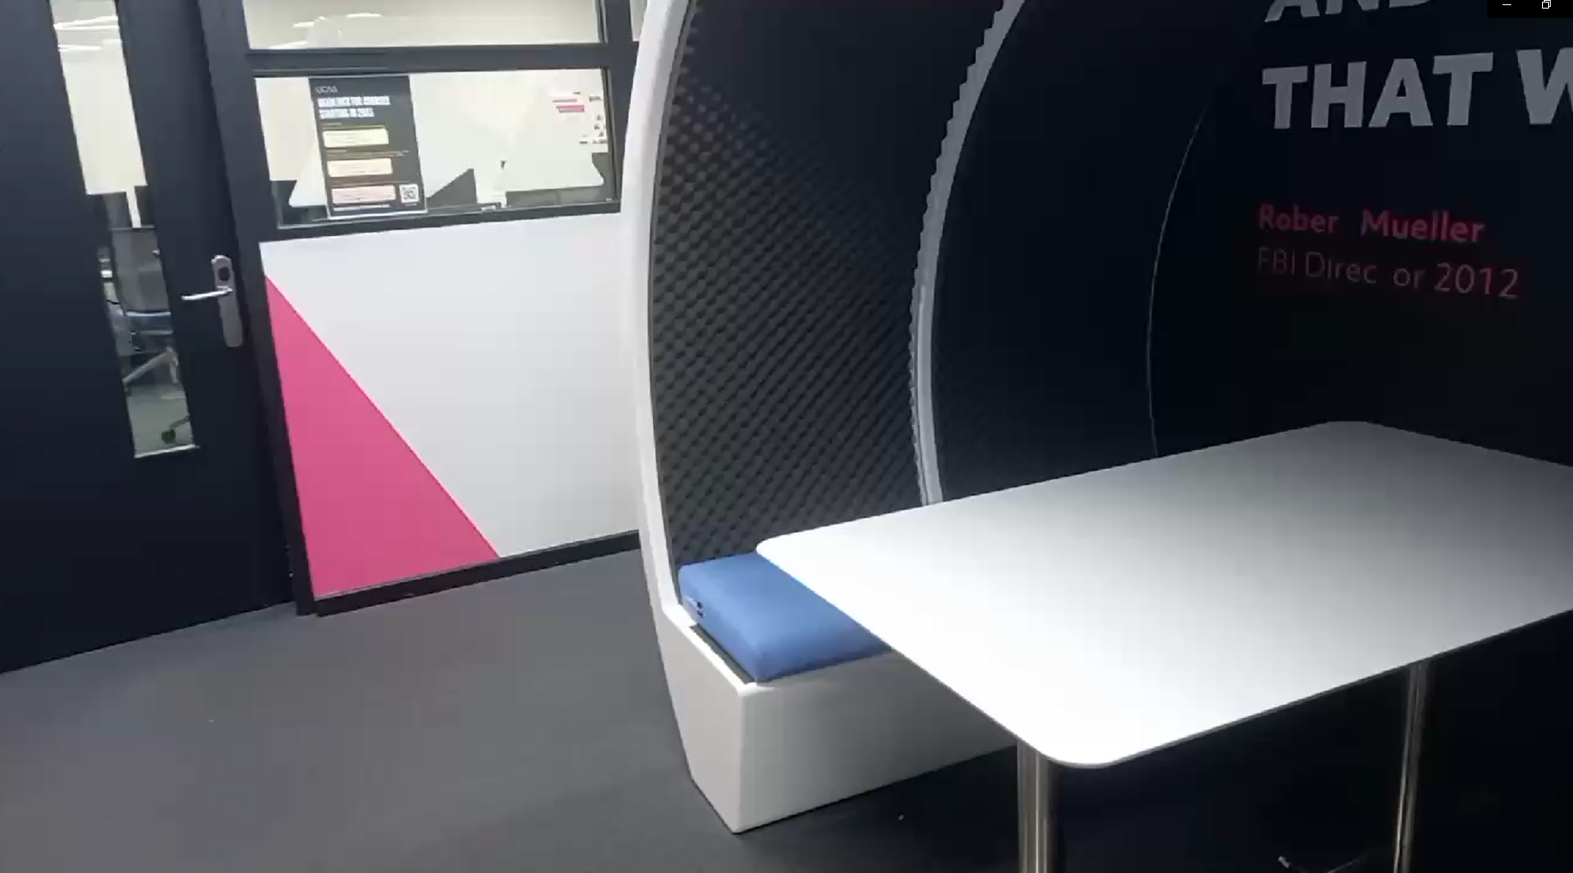
Here are some more booths sandwich have very comfortable seats.
back

Slide 8
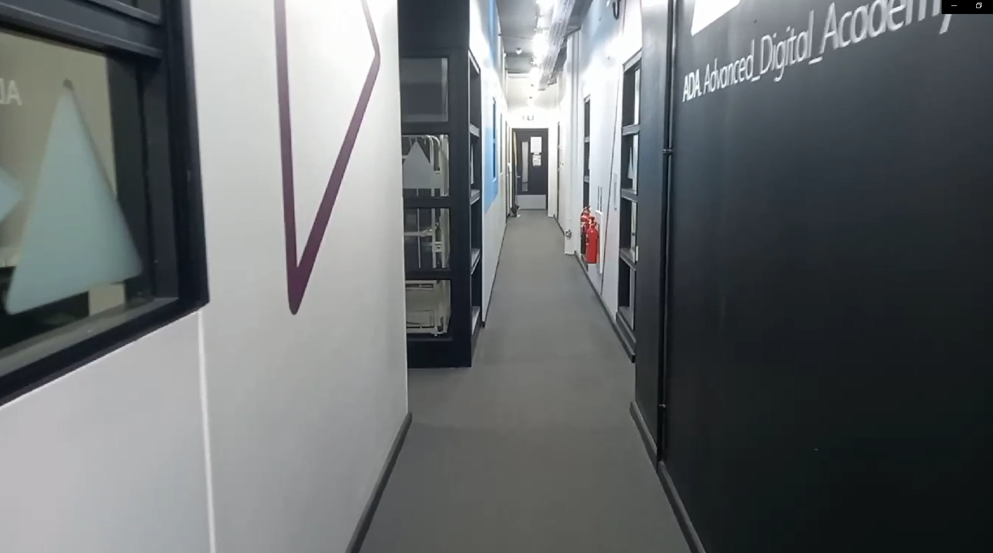
Down this corridor are the rest of the classrooms.
Back

Slide 9
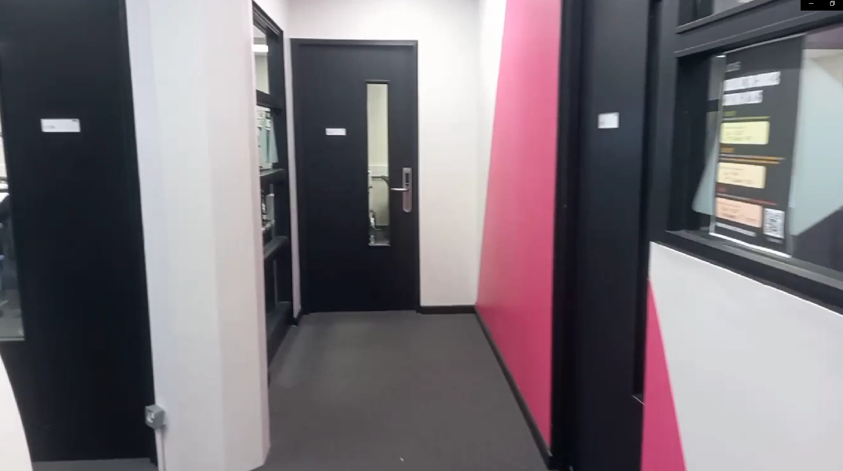
In front of us is the tutors offers.
to our right is a Nova classroom.
you are left is men area with tables and chairs

Slide 10
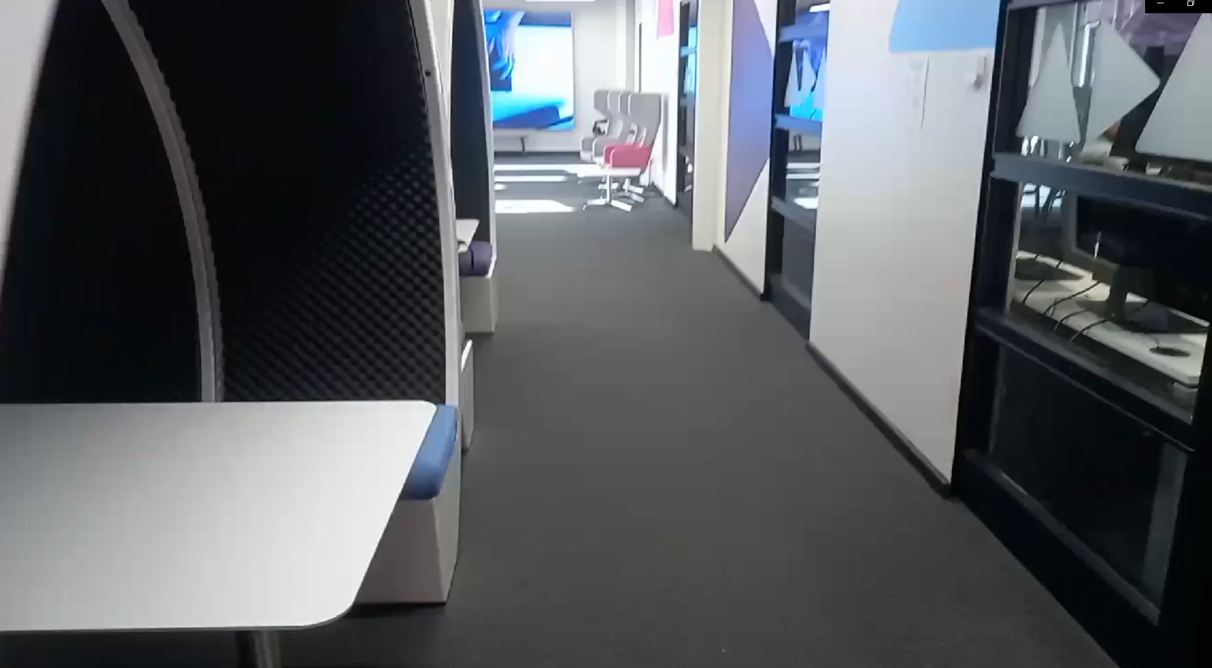

Slide 11
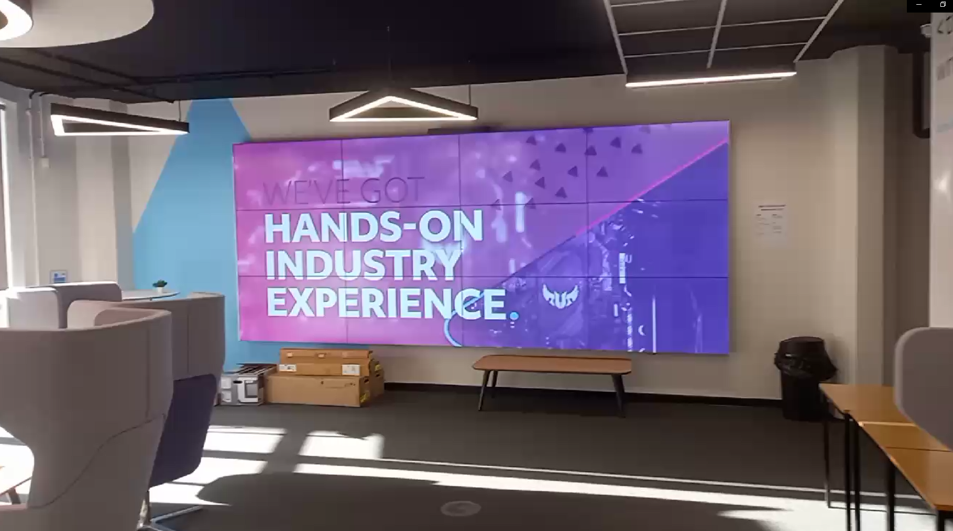
This is end of my interactive PowerPoint I hope you enjoyed looking at the IT department at Gloucestershire college
Back to start

